Slide 1
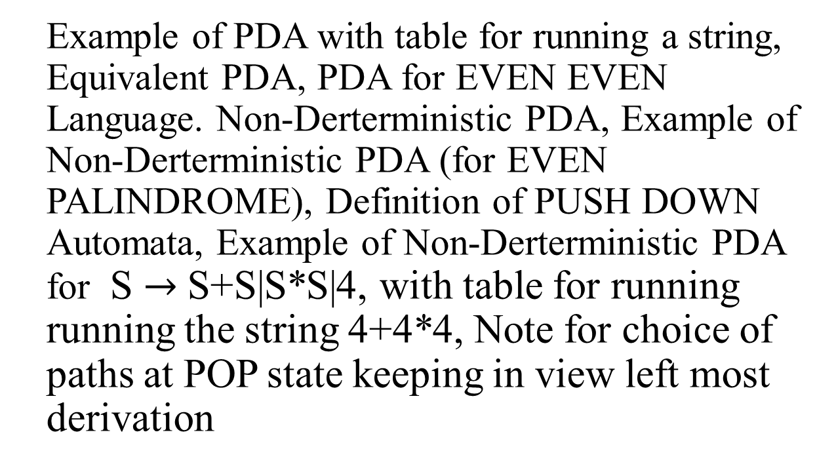
Recap lecture 38

Slide 2
PDA corresponding to CFG
Theorem: Corresponding to any CFG there exists a PDA accepting the language generated by the CFG.
Since an algorithm has already been discussed to convert the CFG in CNF, so the PDA can be constructed corresponding to the CFG. As the CFG in CNF generates all the nonnull words of the corresponding CFL, so accepting the null string (if it is contained in the CFL), can be managed separately. Following is an example in this regard

Slide 3
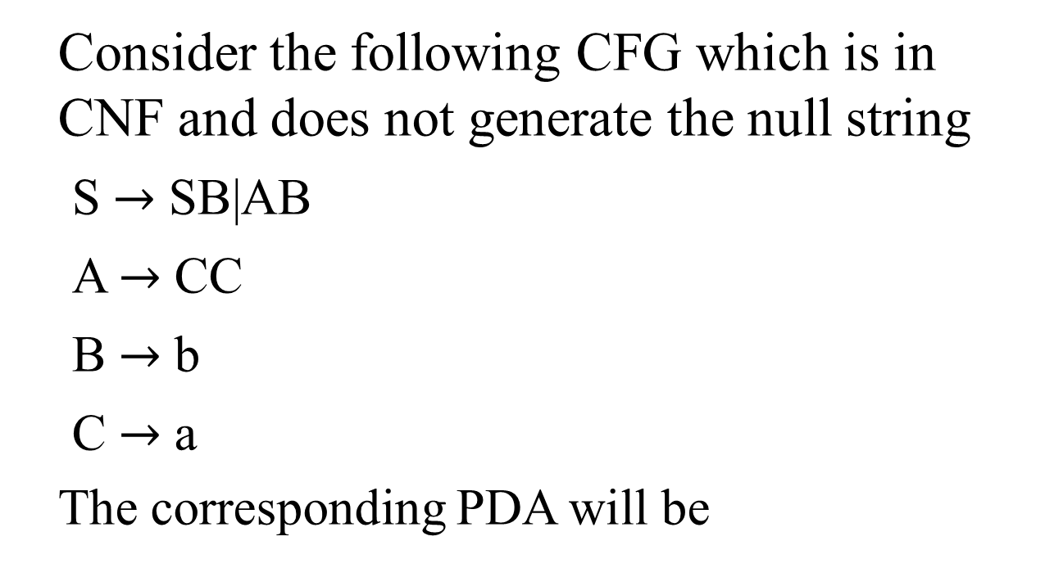
Example

Slide 4
a
b
RD₁
RD₂
AT
ST
∆
C
B
PH S
∆
PP
RD₃
S
A
S
PH B
PH B
PH C
PH S
PH A
PH C

Slide 5
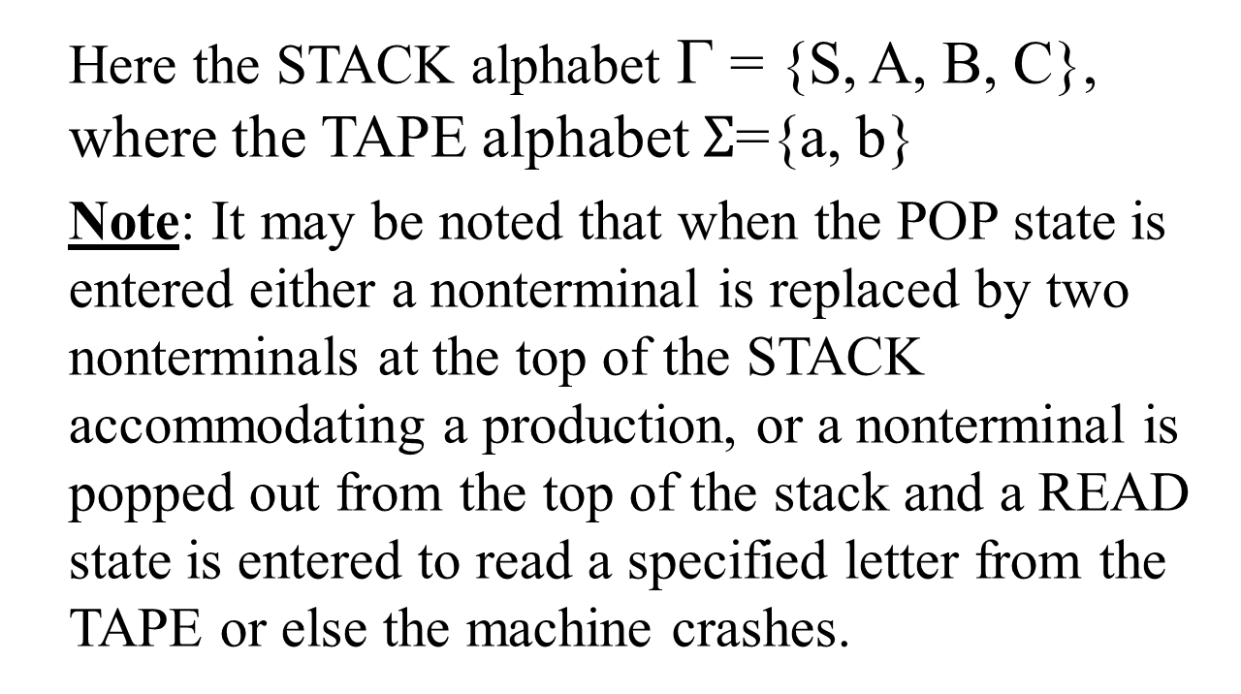
Example continued …

Slide 6
Example continued …
The choice of path taken at POP state to accommodate the word belonging to the CFL can be determined by the left most derivation of the word. Consider the word aab with its left most derivation, as follows

Slide 7
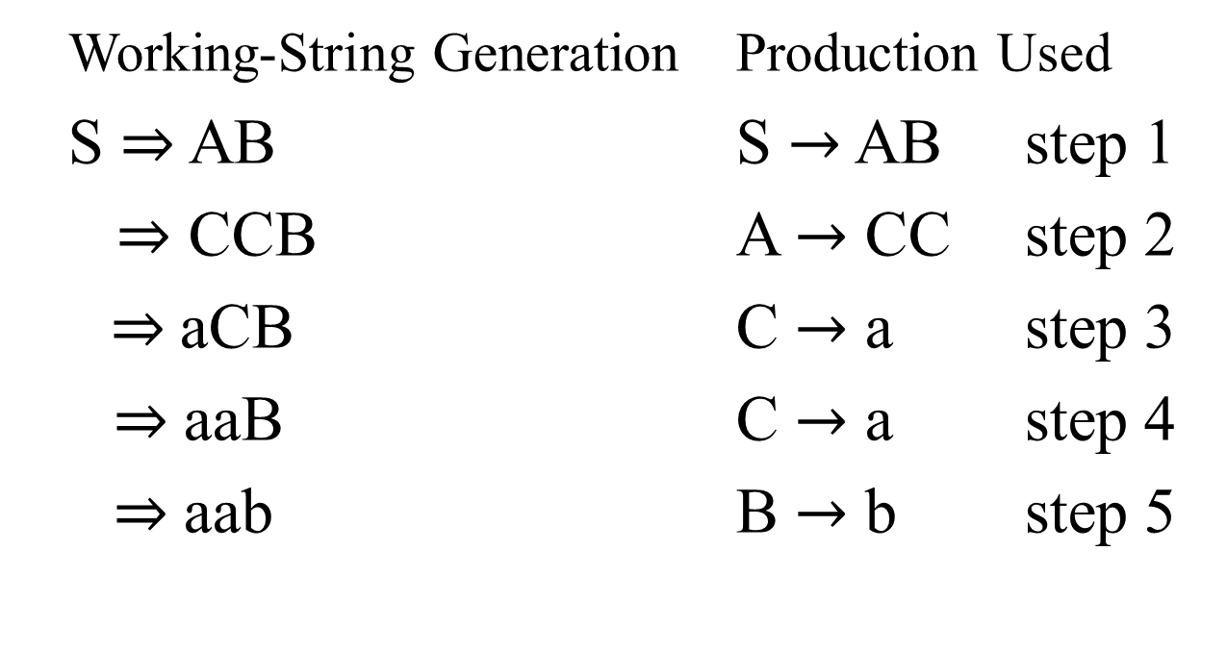
Example continued …

Slide 8
Example continued …
First of all the START state is entered
The PUSH S state is entered
STACK
TAPE
∆…
aab∆…
STACK
TAPE
S
aab∆…

Slide 9
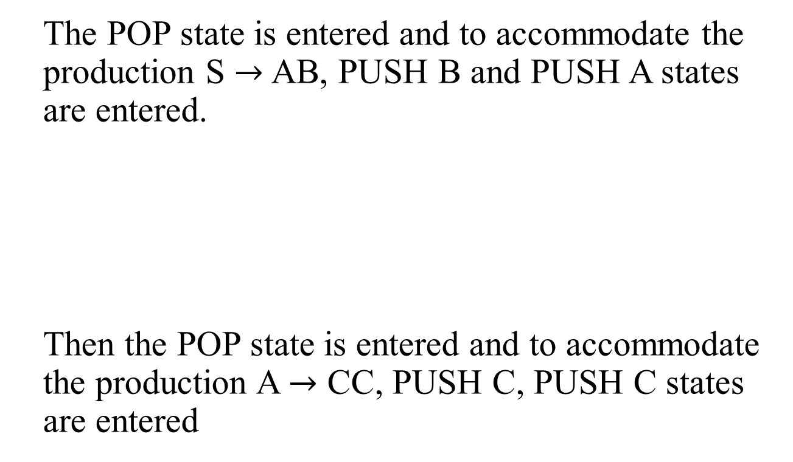
Example continued …
STACK
TAPE
AB
aab∆…

Slide 10
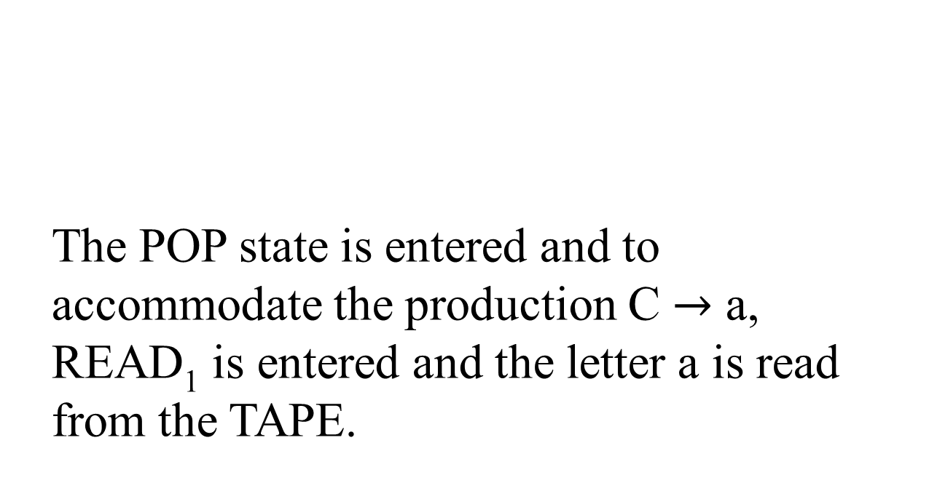
Example continued …
STACK
TAPE
CCB
aab

Slide 11
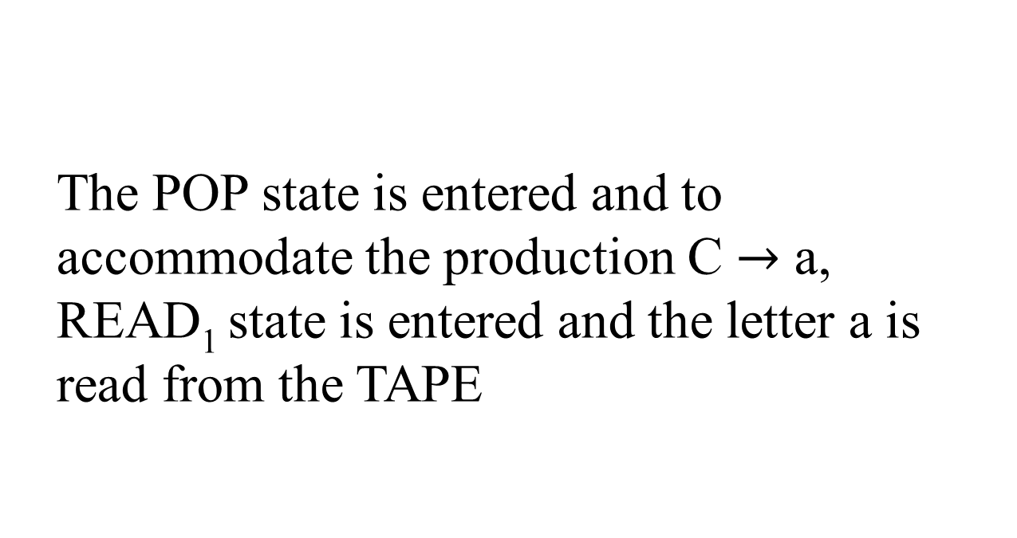
Example continued …
STACK
TAPE
CB
aab
STACK
TAPE
B
aab

Slide 12
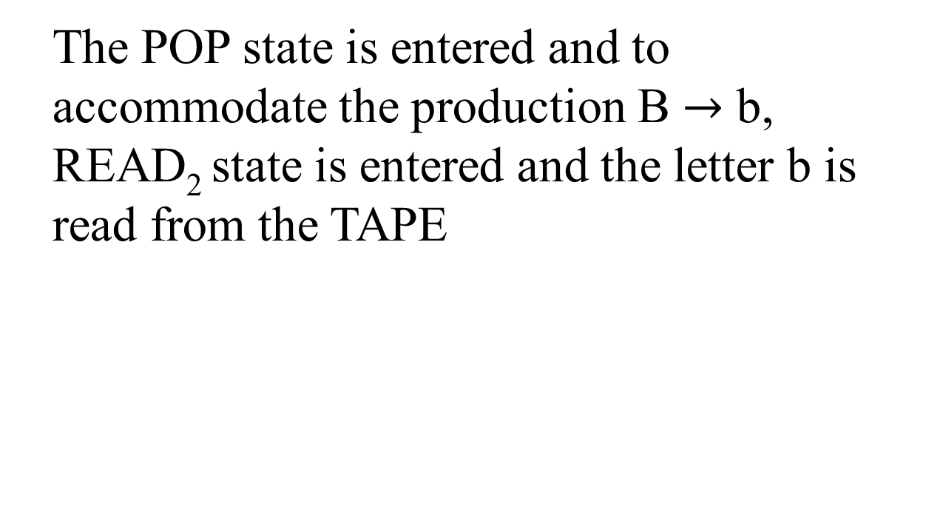

Example continued …
STACK
TAPE
aab

Slide 13
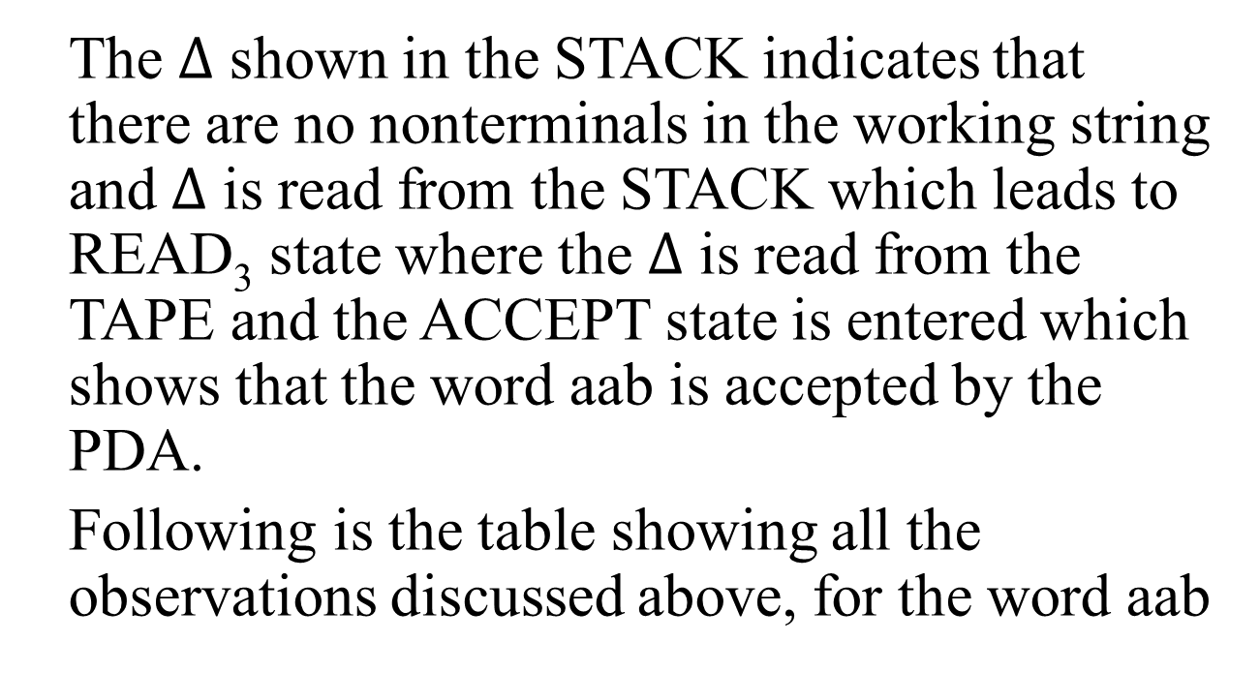
Example continued …

Slide 14


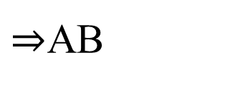
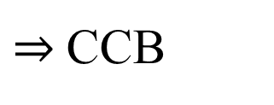
Example continued …
Left most derivation
STATE
STACK
TAPE
START
aab
S
PUSH S
S
aab
POP
aab
PUSH B
B
aab
PUSH A
AB
aab
POP
B
aab
PUSH C
CB
aab
PUSH C
CCB
aab
POP
CB
aab

Slide 15
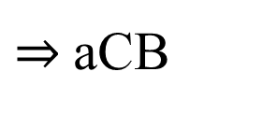
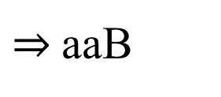

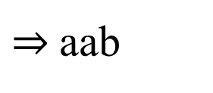
Example continued …
READ₁
CB
aab
POP
B
aab
READ₁
B
aab
POP
aab
READ₂
Δ
aab
POP
Δ
aab
READ₃
Δ
aab
ACCEPT
Δ
aab
Following is an example of building the PDA corresponding to the given CFG

Slide 16
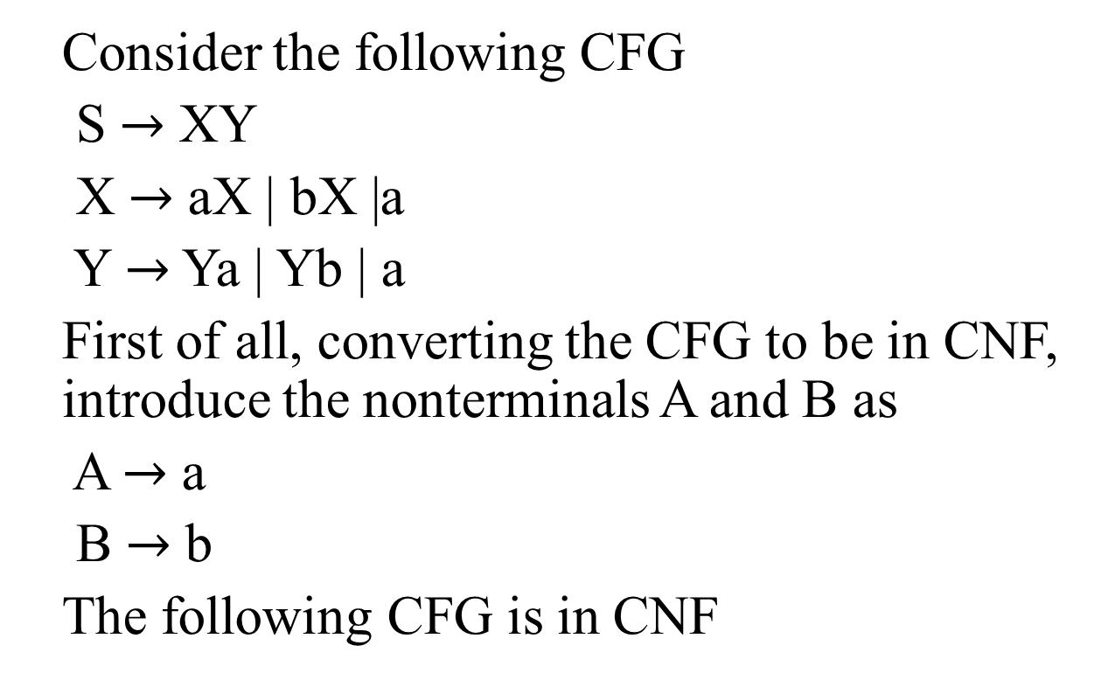
Example

Slide 17
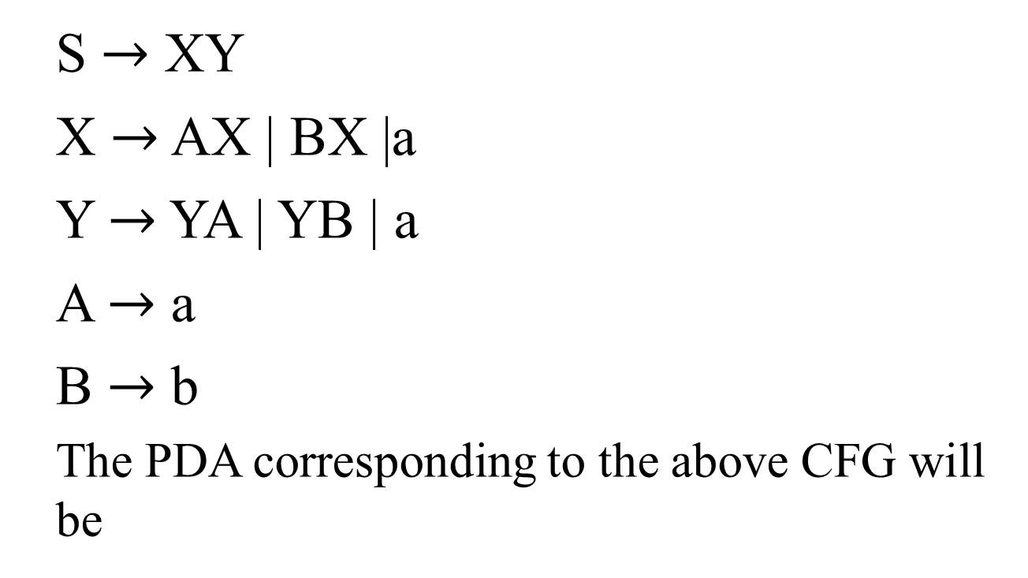
Example continued …

Slide 18
a
a
a
b
RD₁
RD₃
RD₄
RD₂
B
A
AT
ST
Y
X
∆
PH S
∆
PP
RD₅
S
X
X
Y
Y
PH X
PH X
PH A
PH B
PH Y
PH X
PH A
PH B
PH Y
PH Y

Slide 19
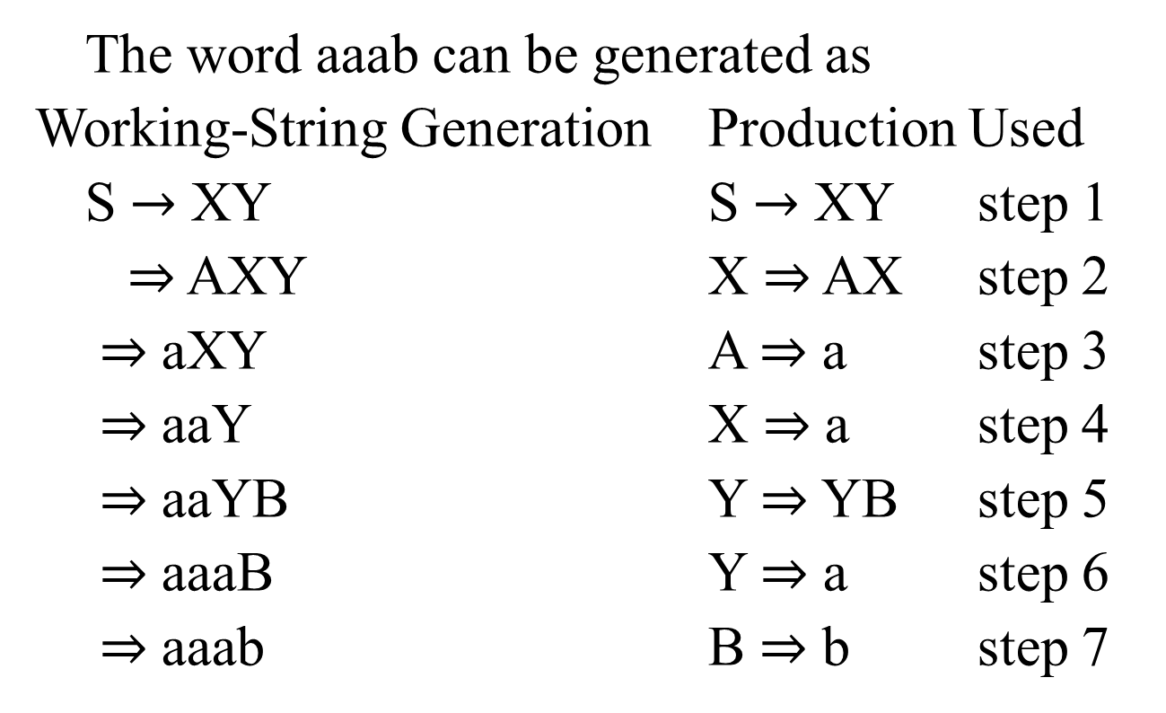
Example continued …

Slide 20
Example continued …
STACK TAPE
STACK TAPE
(ST) ∆
aaab
(PP) Y
aaab
(PH S) S
aaab
(RD₁) Y
aaab
(PP) ∆
aaab
(PP) ∆
aabb
(PH Y) Y
aaab
(PH B) B
aabb
(PH X) XY
aaab
(PH Y)YB
aabb
(PP) Y
aaab
(PP) B
aaab
(PH X)XY
aaab
(RD₂) B
aaab
(PHA)AXY
aaab
(PP) ∆
aaab
(PP) XY
aaab
(RD₄) ∆
aaab
(RD₃)XY
aaab
(PP) ∆
∆

Slide 21
Summing Up
PDA corresponding to CFG, Examples of PDA corresponding to CFG

